Slide 1
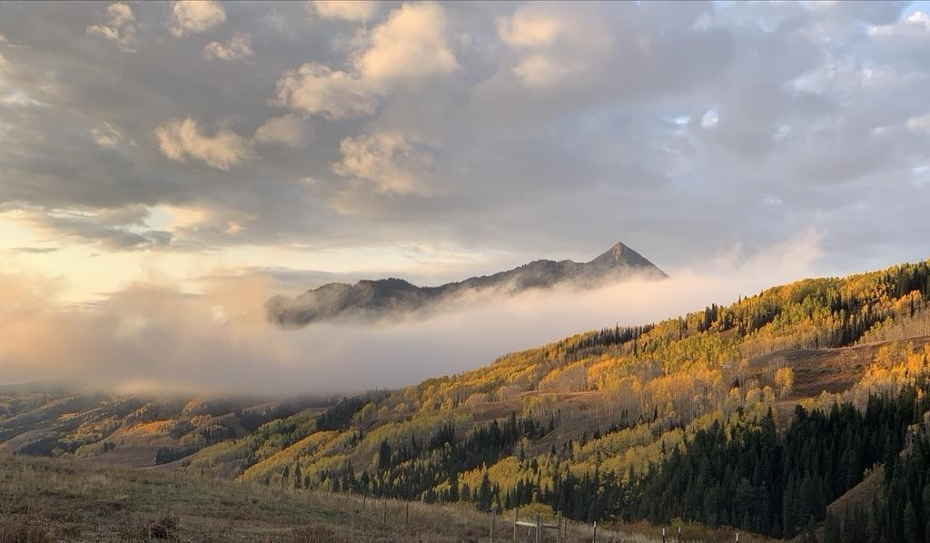
Welcome to the 1st
SPLASH/SAIL/SOS (S³) Workshop!
1-3 November 2023
Boulder, Colorado

Slide 2
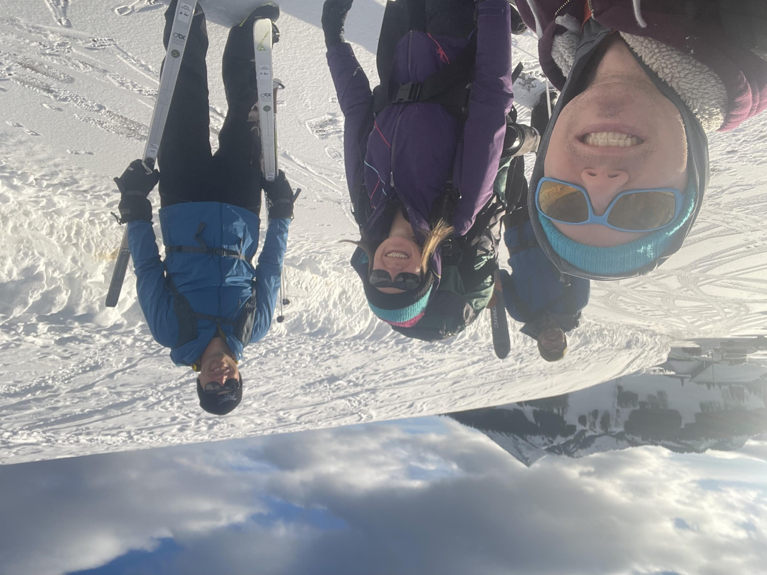
Welcome and Background
S³ Workshop, Boulder CO, 1-3 November 2023

Slide 3
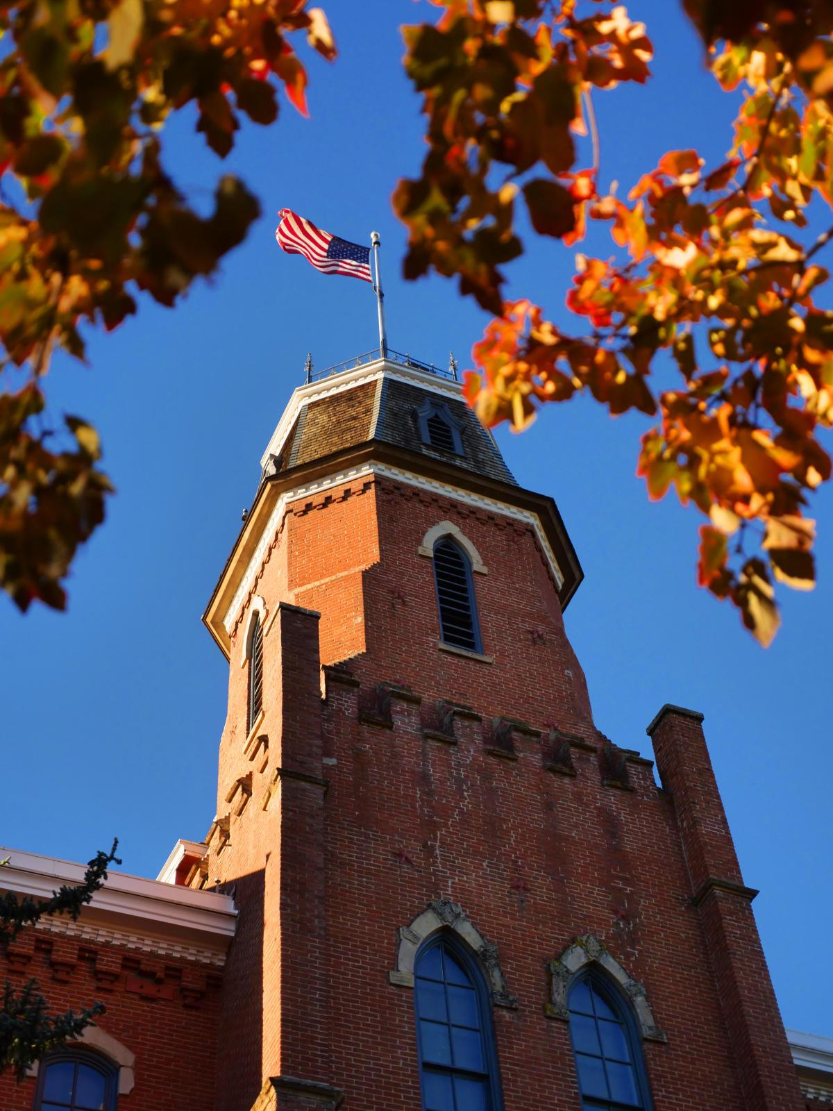
Meeting Objectives
Relationship Building: Support development of joint S³ science team and community through social interaction. Build collaborations and sense of common purpose and foster a “team” mindset between research groups.
Information Sharing: Provide information on recently-completed, current, and planned studies using S³ data. Share information on instrument capabilities, dataset availability, data product development, and upcoming meetings/events of interest.
Developing Next Steps: Plan an agenda, with action-items and deliverables, for S³ science in the coming year. Develop plans for data distribution, accessibility, and sharing.
S³ Workshop, Boulder CO, 1-3 November 2023

Slide 4
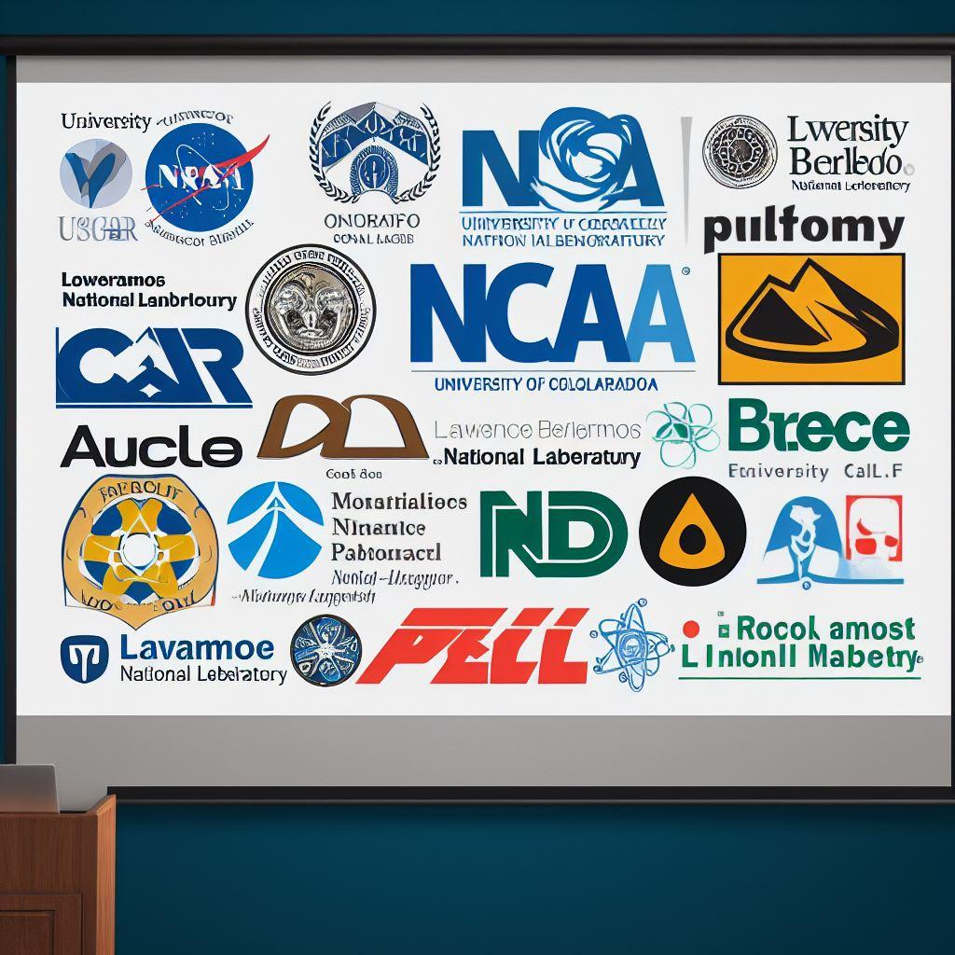
Objective 1: Relationship Building
S³ Workshop, Boulder CO, 1-3 November 2023
Bing Image Creator

Slide 5
Objective 1: Relationship Building
S³ Workshop, Boulder CO, 1-3 November 2023

Slide 6
Objective 1: Relationship Building
S³
S³ Workshop, Boulder CO, 1-3 November 2023

Slide 7
Objective 2: Information Sharing
1 November (Multipurpose Room, Kittredge)
12:30-13:00: Registration, Coffee, and Conversation (Coffee, Refreshments, Snacks)
13:00-14:45: Welcome, Logistics, Project Overviews, Meeting Objectives
14:45-15:15: Break and Conversation (Coffee, Refreshments, Snacks)
15:15-17:00: Session 1: Modeling efforts – Parameterization development, process studies, model evaluation, and more!
16:55-17:00: Daily wrap up
2 November (Multipurpose Room, Kittredge)
08:00-08:30: Coffee and Conversation (Coffee, Refreshments, Snacks)
08:30-10:00: Session 2: Instruments and Data – Observed quantities, data availability and quality, and data distribution and documentation plans.
10:00-10:30: Break and Conversation (Coffee, Refreshments, Snacks)
10:30-12:00: Session 3: Precipitation science – radar heads unite!
11:40-12:00: Group photographs [this always takes longer than you think!]
12:00-13:15: Lunch (on your own)
13:15-14:45: Session 4: Aerosol processes and properties – Dust, black carbon, new particle formation
14:45-15:15: Break and Conversation (Coffee, Refreshments, Snacks)
15:15-16:30: Session 5: Lower atmospheric properties and processes – Drainage flows, turbulence, initiation of convection and more!
16:25-16:30: Daily wrap up
17:30-19:30: Social Gathering (The Rayback Collective, Valmont Road, Boulder)
3 November (CIRES Auditorium, Ekeley Sciences)
08:00-08:30: Coffee and Conversation
08:30-10:15: Session 6: The surface situation – surface properties and energy budget
10:30-11:00: Break and Conversation (Coffee, Refreshments, Snacks)
11:00-11:45: Small breakout groups – find your new friends and a place to talk to discuss exciting new science ideas!
11:45-12:15: Session 7: Team interactions and next steps – action items, tasking, meetings, upcoming meetings and workshops, next year’s gathering
12:15-12:30: Closing Session
S³ Workshop, Boulder CO, 1-3 November 2023

Slide 8
Objective 2: Information Sharing
It’s a dense agenda…
Please upload your presentations ahead of time! Preferably the night before…
Please be prepared to give your presentation when the time comes.
Please stay on time (for most, 10 minutes including questions and transition!)
Expected Behaviors:
Please be respectful of people’s work and ideas and consider how you might contribute!
Please be ready to listen and learn about work being conducted!
Please be courteous to people of all experience levels – be inclusive!
Appreciate and accommodate similarities and differences!
Please Avoid:
Derogatory language
Personal attacks
Unacceptable use of intellectual property
Violence or any other form of unwelcome attention or contact
S³ Workshop, Boulder CO, 1-3 November 2023

Slide 9
Objective 3: Developing Next Steps
1 November (Multipurpose Room, Kittredge)
12:30-13:00: Registration, Coffee, and Conversation (Coffee, Refreshments, Snacks)
13:00-14:45: Welcome, Logistics, Project Overviews, Meeting Objectives
14:45-15:15: Break and Conversation (Coffee, Refreshments, Snacks)
15:15-17:00: Session 1: Modeling efforts – Parameterization development, process studies, model evaluation, and more!
16:55-17:00: Daily wrap up
2 November (Multipurpose Room, Kittredge)
08:00-08:30: Coffee and Conversation (Coffee, Refreshments, Snacks)
08:30-10:00: Session 2: Instruments and Data – Observed quantities, data availability and quality, and data distribution and documentation plans.
10:00-10:30: Break and Conversation (Coffee, Refreshments, Snacks)
10:30-12:00: Session 3: Precipitation science – radar heads unite!
11:40-12:00: Group photographs [this always takes longer than you think!]
12:00-13:15: Lunch (on your own)
13:15-14:45: Session 4: Aerosol processes and properties – Dust, black carbon, new particle formation
14:45-15:15: Break and Conversation (Coffee, Refreshments, Snacks)
15:15-16:30: Session 5: Lower atmospheric properties and processes – Drainage flows, turbulence, initiation of convection and more!
16:25-16:30: Daily wrap up
17:30-19:30: Social Gathering (The Rayback Collective, Valmont Road, Boulder)
3 November (CIRES Auditorium, Ekeley Sciences)
08:00-08:30: Coffee and Conversation
08:30-10:15: Session 6: The surface situation – surface properties and energy budget
10:30-11:00: Break and Conversation (Coffee, Refreshments, Snacks)
11:00-11:45: Small breakout groups – find your new friends and a place to talk to discuss exciting new science ideas!
11:45-12:15: Session 7: Team interactions and next steps – action items, tasking, meetings, upcoming meetings and workshops, next year’s gathering
12:15-12:30: Closing Session
S³ Workshop, Boulder CO, 1-3 November 2023

Slide 10
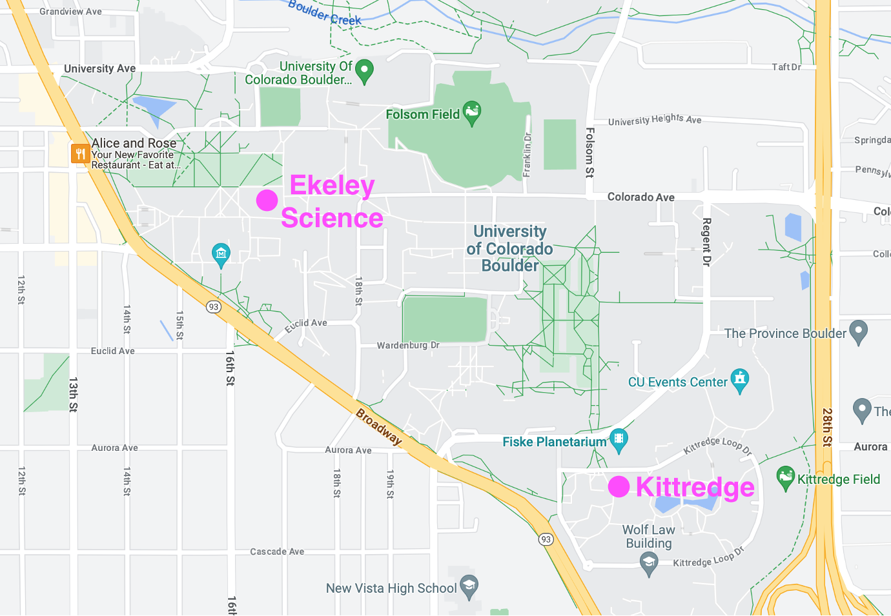
Site Logistics
Wednesday and Thursday will be held here at Kittredge.
Friday will be held at the CIRES auditorium. This is in the CIRES building, which is attached to Ekeley Sciences. There will be signs!
See logistics/agenda document for parking and other information.
S³ Workshop, Boulder CO, 1-3 November 2023

Slide 11
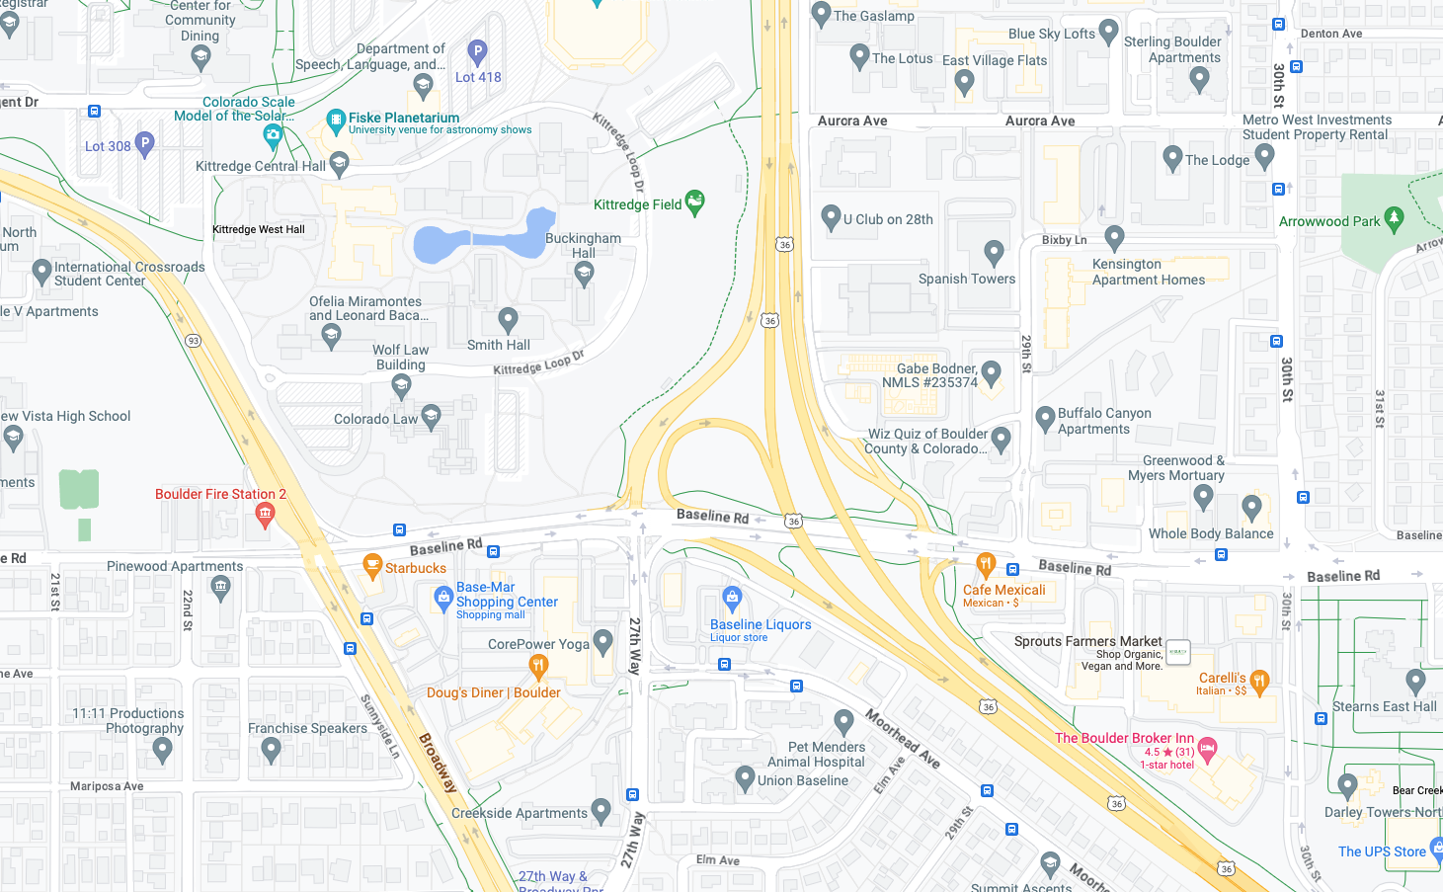
Lunch Logistics (Thursday)
Basemar Shopping Plaza:
- The Taj (Indian)
- Noodles and Company
- Doug’s Diner
- May Wah (Pho)
- Fast Food Options
You are here…
Williams Village
- Café Mexicali
- Pho Kitchen Bar and Grill
- Dark Horse
- Cosmo’s Pizza
- Carelli’s (Italian)
S³ Workshop, Boulder CO, 1-3 November 2023

Slide 12
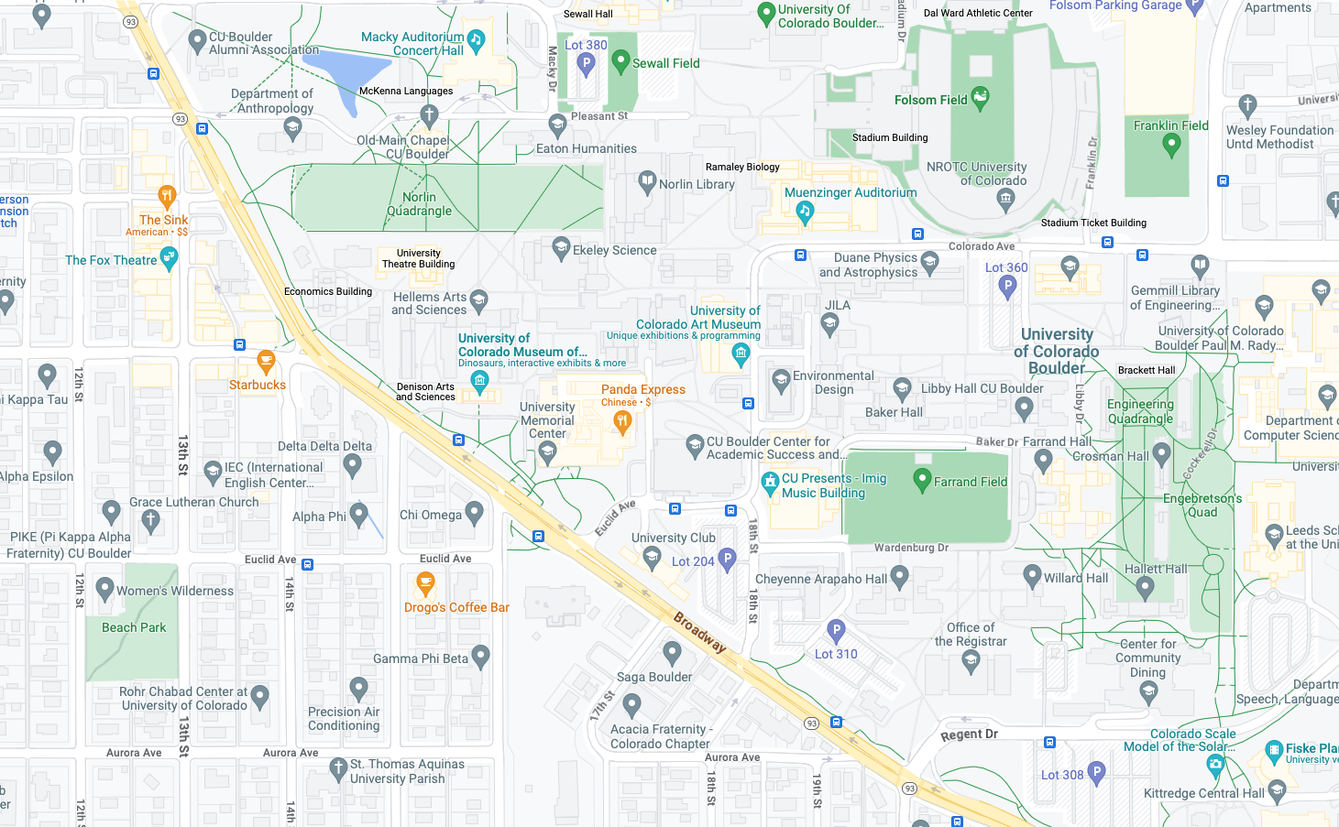
Lunch Logistics (Thursday)
The Hill
- Many options, longer walk…
- Half Fast Subs
- Café Aion
- Sushi Hana
- The Sink
- Illegal Pete’s
- Deli Zone
- Various other places…
You are here…
S³ Workshop, Boulder CO, 1-3 November 2023

Slide 13
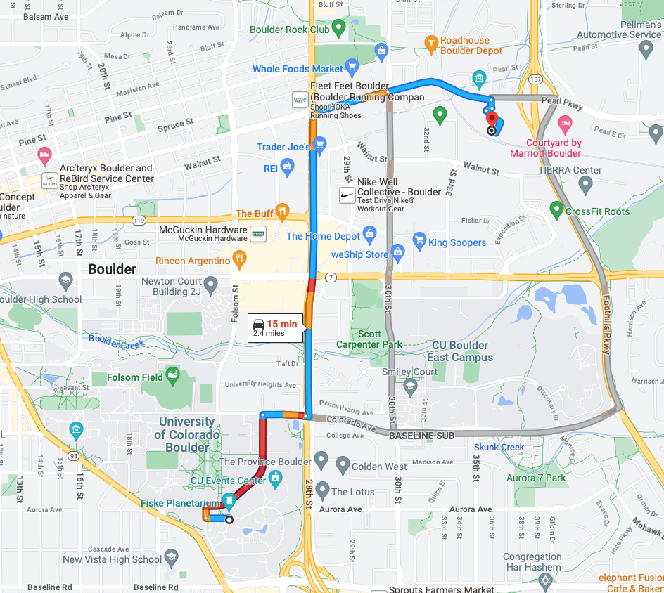
Social Activities (Wednesday)
No-Host Boulder Climate and Water Happy Hour (thanks Ethan!):
- 5-7ish pm, Sanitas Brewing Company
- Food options are limited, though there is a taco truck!
S³ Workshop, Boulder CO, 1-3 November 2023

Slide 14
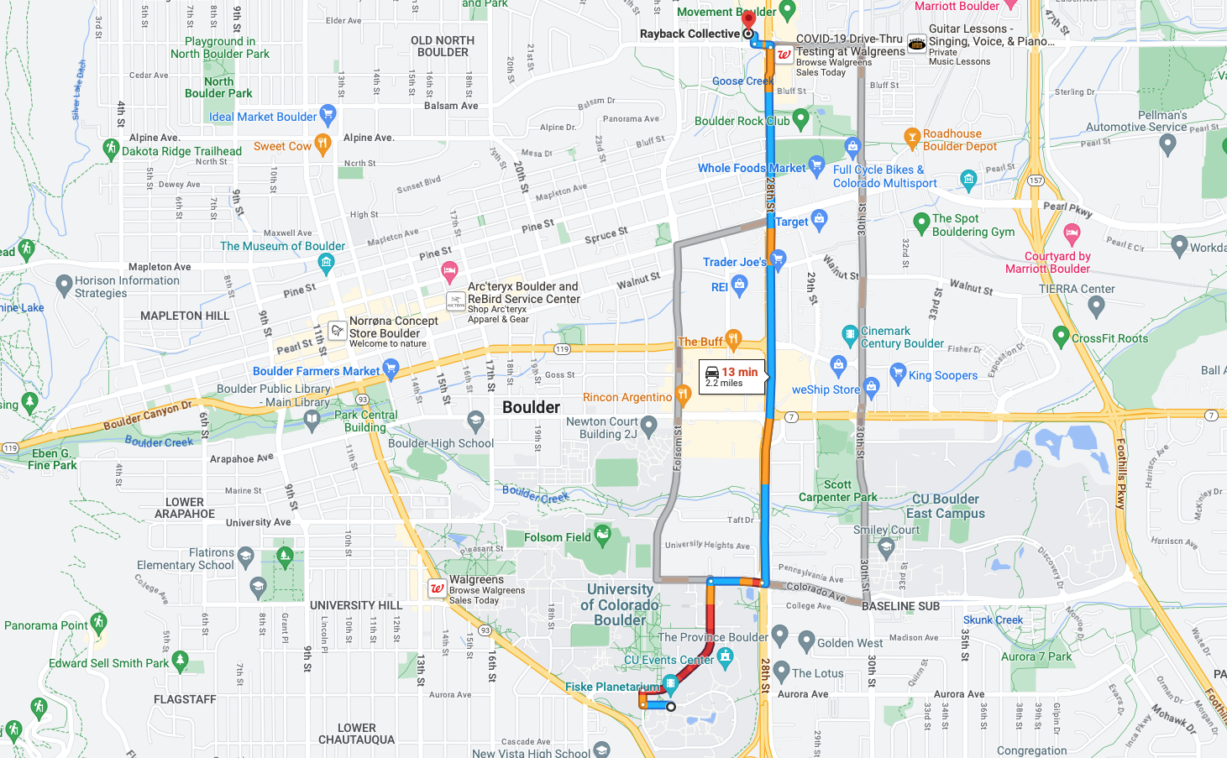
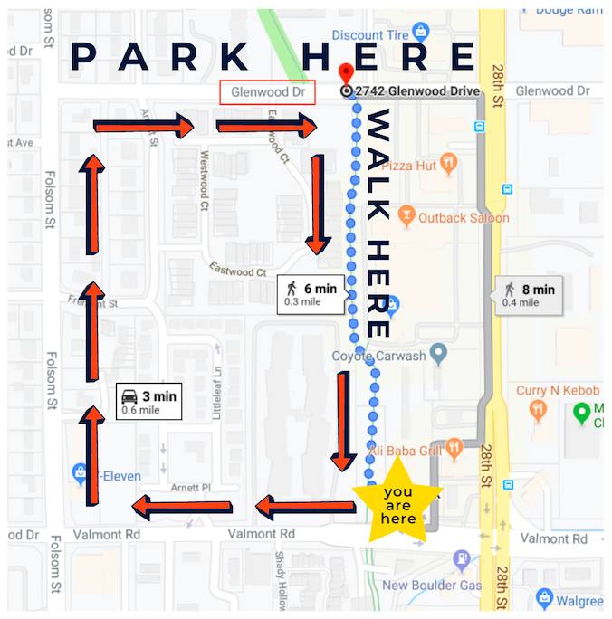
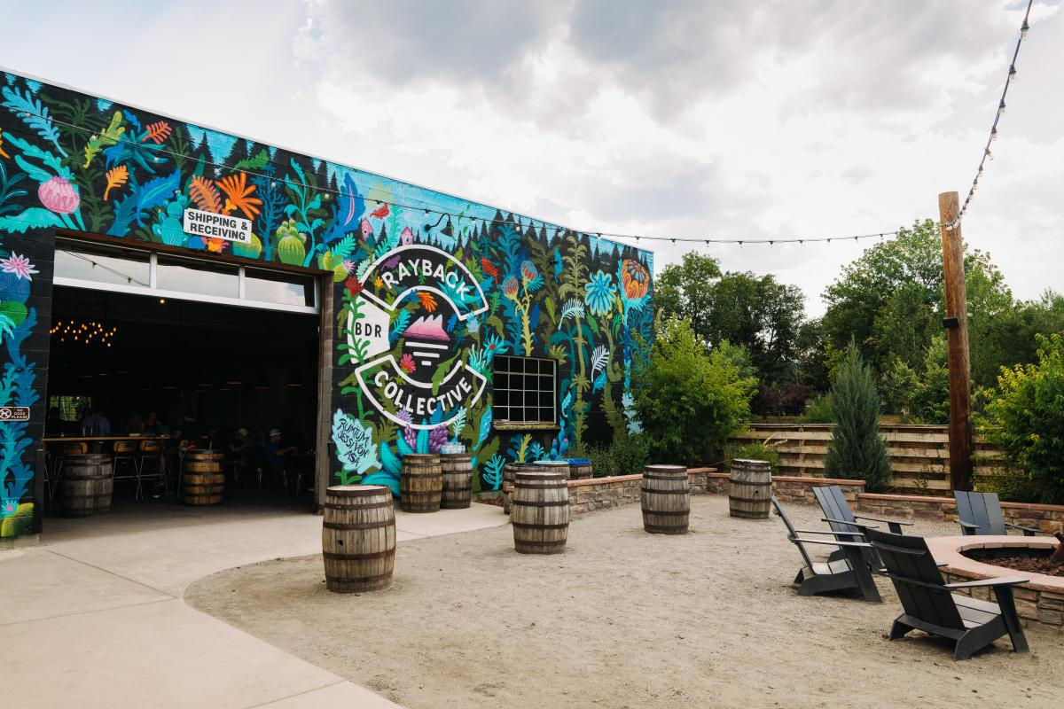
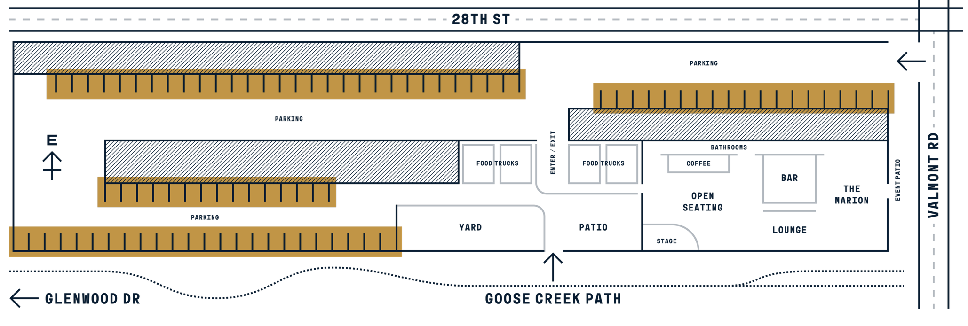
Social Activities (Thursday)
No-Host Evening gathering at The Rayback Collective (2775 Valmont Road)
Food can be purchased from food trucks on site.
Good beer and other beverages
But – parking is *very* limited, particularly on a nice evening.
Please consider carpooling or taking an Uber/Lyft
S³ Workshop, Boulder CO, 1-3 November 2023

Slide 15
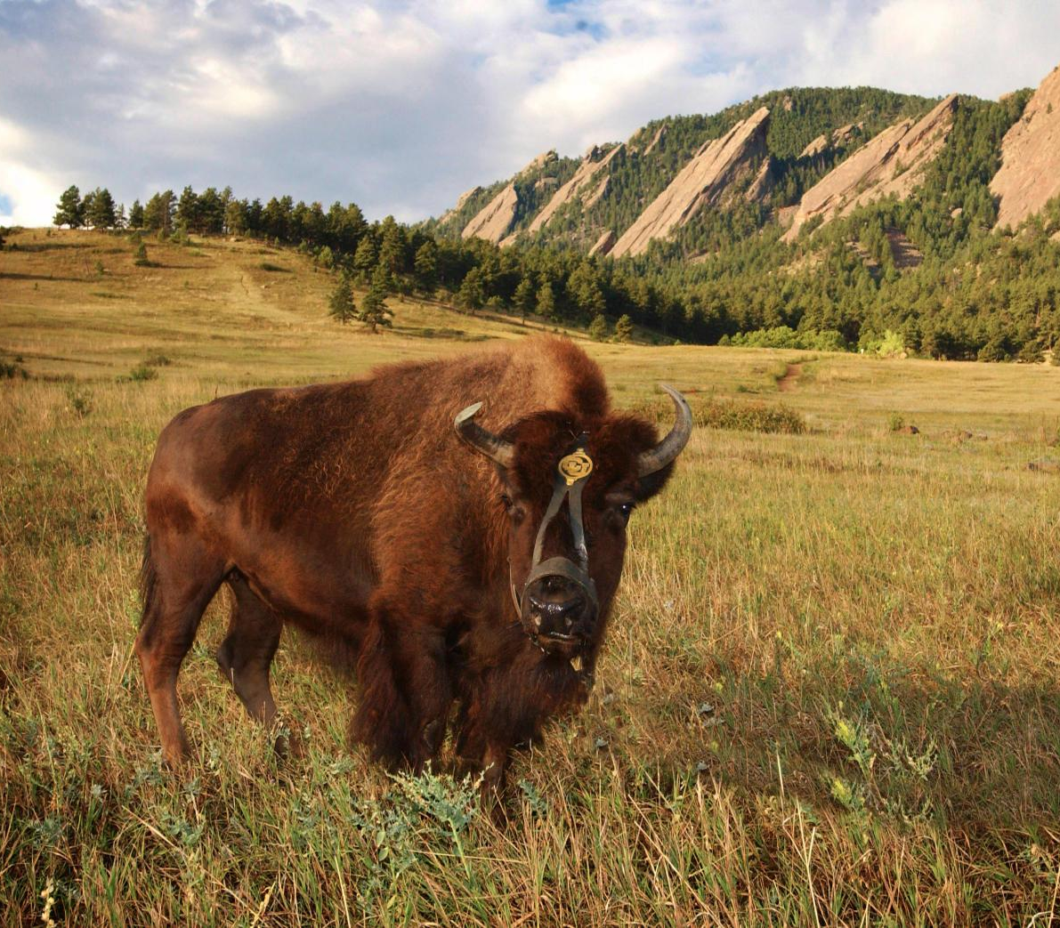
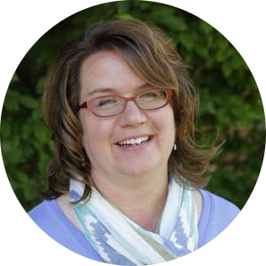
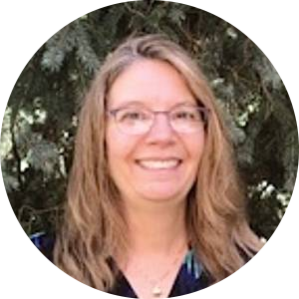
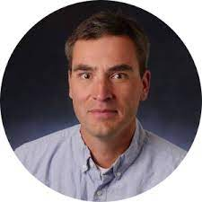
CU/CIRES Event Team
Questions, Compliments:
Complaints:
Linda Pendergrass
Wendy Elder
Gijs de Boer
S³ Workshop, Boulder CO, 1-3 November 2023

Slide 16
Meet and Greet!
First, a little fun – calculate your S³ score!
For example, Gijs’s S³ score is:
-
=
3804 m
(Kachina Peak Summit, Taos)
18 m
(Hengelo, NL)
3786
Now, talk with others in the room and compare your scores. Line up in descending order by S³ score. Those online, please enter your score in the chat!
S³ Workshop, Boulder CO, 1-3 November 2023

Slide 17
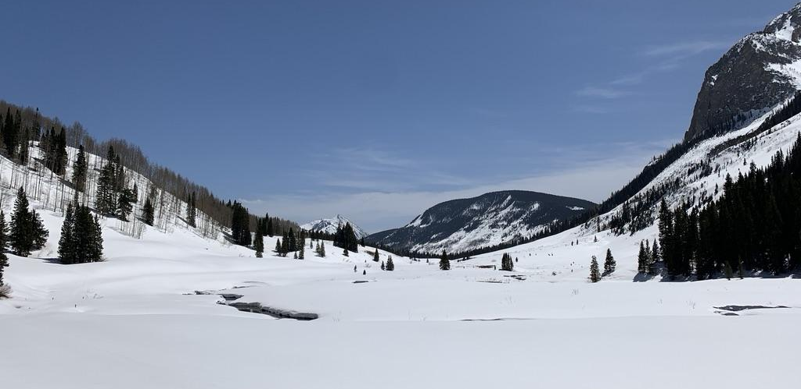
Meet and Greet!
S³ Workshop, Boulder CO, 1-3 November 2023

